Slide 1

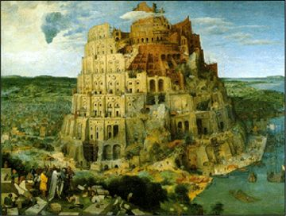
50 Years of Telling Computers What To Do:
The Evolution Of Programming Languages
Nick Benton
Queens’ College
&
Microsoft Research

Slide 2
Computers do all the amazing things they do because people have told them how to
By writing programs: texts in a programming language
We’ve had programming languages for about 50 years now
During which time, we’ve invented somewhere between 2000 and 4000 of the things (roughly the same order as the number of natural languages in use)
There’s a precise sense in which they’re (nearly) all equivalent
Why?

Slide 3
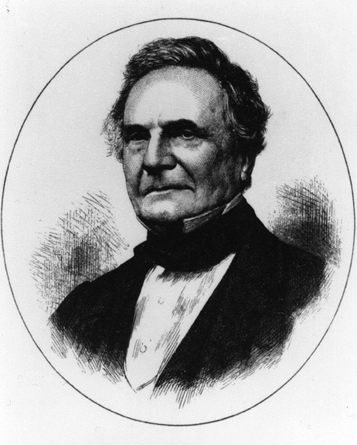
Babbage’s Analytical
Engine ~1834
Five logical components, the store, the mill, the control, the input and the output. The store contains :-
... all the variables to be operated upon, as well as all those quantities which had arisen from the results of other operations.
The mill is the place :-
... into which the quantities about to be operated upon are always bought.
The control, operated by punched cards :-
Every set of cards made for any formula will at any future time recalculate the formula with whatever constants may be required.
Thus the Analytical Engine will possess a library of its own. Every set of cards once made will at any time reproduce the calculations for which it was first arranged.

Slide 4

Computer Architecture
0
an instruction
an instruction
an instruction
..
..
..
..
1
2
registers
3
4
program
counter
5
arithmetic
and logic
6
7
program (control)
8
cpu (mill)
9
10
.....
memory (store)

Slide 5
Computer Architecture
0
an instruction
an instruction
an instruction
..
..
..
..
1
2
registers
3
4
program
counter
5
arithmetic
and logic
6
7
program (control)
8
cpu (mill)
9
10
.....
memory (store)

Slide 6
Computer Architecture
0
0
0
1
0
1
0
0
1
an instruction
an instruction
an instruction
..
..
..
..
1
1
0
0
1
0
0
0
0
2
0
0
1
1
0
0
1
0
registers
3
0
0
0
0
0
0
0
0
4
1
1
0
0
0
0
0
1
program
counter
5
0
0
0
0
0
0
1
0
arithmetic
and logic
6
0
0
1
0
0
1
0
1
7
0
0
1
1
1
0
0
0
program (control)
8
0
0
1
0
0
1
0
0
cpu (mill)
9
1
1
0
0
1
0
0
0
10
1
1
0
0
0
0
1
0
.....
memory (store)

Slide 7
Computer Architecture
0
48
an instruction
an instruction
an instruction
..
..
..
..
1
53
2
145
registers
3
32
4
201
program
counter
5
96
arithmetic
and logic
6
2
7
32
program (control)
8
254
cpu (mill)
9
3
10
154
.....
memory (store)

Slide 8
Computer Architecture
0
48
an instruction
an instruction
an instruction
..
..
..
..
1
53
2
145
registers
3
32
4
201
program
counter
5
96
arithmetic
and logic
6
2
7
32
program (control)
8
254
cpu (mill)
9
3
10
154
.....
memory (store)

Slide 9
Computer Architecture
0
T
an instruction
an instruction
an instruction
..
..
..
..
1
H
2
E
registers
3
4
C
program
counter
5
A
arithmetic
and logic
6
T
7
program (control)
8
S
cpu (mill)
9
A
10
T
.....
memory (store)

Slide 10

Computer Architecture
0
an instruction
an instruction
an instruction
..
..
..
..
1
2
registers
3
4
program
counter
5
arithmetic
and logic
6
7
program (control)
8
cpu (mill)
9
10
.....
memory (store)

Slide 11
Computer Architecture
0
an instruction
an instruction
an instruction
..
..
..
..
1
2
registers
3
4
program
counter
5
arithmetic
and logic
6
7
program (control)
8
cpu (mill)
9
10
.....
copy location 1 to register 0
memory (store)

Slide 12
Computer Architecture
0
3
an instruction
an instruction
an instruction
..
..
..
..
1
11
14
2
registers
3
4
program
counter
5
arithmetic
and logic
6
7
program (control)
8
cpu (mill)
9
10
.....
add r0 and r1 with result in r2
memory (store)

Slide 13
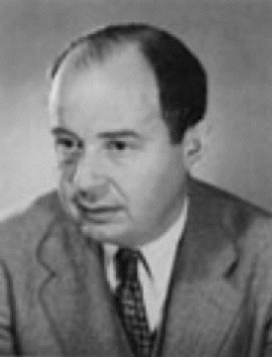
Computer Architecture
0
an instruction
an instruction
an instruction
..
..
..
..
1
2
registers
3
4
program
counter
5
arithmetic
and logic
6
7
program (control)
8
cpu (mill)
9
10
John von Neumann
.....
add r0 and r1 with result in r2
memory (store)

Slide 14
Assemblers
Entering each machine instruction in terms of “on”s and “off”s gets boring fast
Letters are data. Code is data. Computers process data.
So write a program to translate a symbolic representation of another program into the actual bits
von Neumann: "It is a waste of a valuable scientific computing instrument to use it to do clerical work."

Slide 15
An Assembly Language Program
Symbolic names for addresses which are calculated by the assembler. An identifier in the text stands for an address at runtime
.text
.globl start
start: # execution starts here
la $t2,str # t2 points to the string
li $t1,0 # t1 holds the count
nextCh:
lb $t0,($t2) # get a byte from string
beqz $t0,strEnd # zero means end of string
add $t1,$t1,1 # increment count
add $t2,1 # move pointer one character
j nextCh # go round the loop again
strEnd:
# printing stuff elided...
.data
str: .asciiz "hello world"
Comments
Sensible names for instructions
Constant data written in convenient form too

Slide 16
Assemblers start to grow...
Macros
Parameterized macros
Subroutine libraries
Simple calculations performed by the assembler
But an assembler is specific to one kind of processor
And it’s still a time-consuming and error-prone way to program

Slide 17
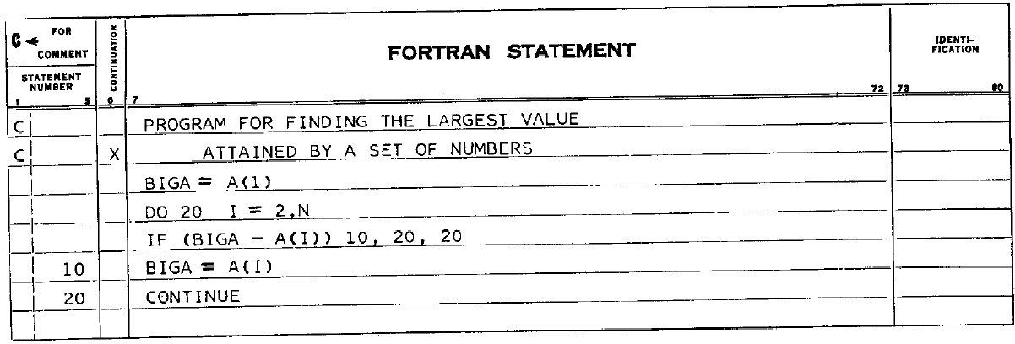
Fortran: Backus, 1957
Algebraic notation
Real numbers as well as integers
Arrays
(sort of) machine independent
Produced fast compiled code
(von Neumann: “Why would you want more than machine language?”)

Slide 18
Imperative Languages
Fortran I, II, III, IV(66), V(77), 90, 95,2000
Cobol 59,61,65,68,74,85,OO(97),2002
Algol 58,60,68
CPL, BCPL, C 78,89,90,95,99
Pascal, Oberon, Oberon 2, Modula, Modula 2,
Lots more...

Slide 19
What do they all have in common?
The model they present to the programmer is still essentially that of Babbage and von Neumann
  Instructions, commands, statements which make changes to a store
  Parts of the store named by variables
  Expressions which are evaluated relative to the current store
  Flow of control forms:
    jump to that point in the program
    do this n times
    do this until some condition becomes true
    if a condition is true do this else do that
Plus various forms of parameterized subprogram (procedure, subroutine, function,...)
  These are defined and named once
  They may be used (called, invoked) many times and with different values for the parameters
  Calling may change the store and may return a value

Slide 20
Trivial lexical differences
  What constitutes a valid variable or procedure name (lower case is nice!)
  how you write multiplication
  how statements are separated or terminated
  how you write comments
  Block structure (if any)
    while (..) do begin...end
    while (..) { ... }
    while () do ... endwhile

Slide 21
Different sorts of “stuff” to work on
What sort of values can they compute with? And what operations are provided?
  integers and reals of various sizes
  booleans, characters
  strings (=arrays of characters? ending with a special character or stored with a length? updateable?)
  arrays (multidimensional? of which types? variable size?)
  builtin structural types (pairs, records, unions)
  user-defined types?
  dynamic datastructures?
  procedures first-class?

Slide 22
Binding etc.
Rules for scoping, nesting, binding and parameter passing.
Generally confuse CS students

Slide 23
Pass by value & by reference
program valueExample(output);
var x,y : integer;
procedure NotSwapValues(p,q : integer);
var temp;
begin
temp := p;
p := q;
q := temp;
end;
begin
x = 1;
y = 2;
NotSwapValues(x,y);
writeln('x = ' x:1, ', y = ' y:1);
end.
program valueExample(output);
var x,y : integer;
procedure SwapValues(var p,q : integer);
var temp;
begin
temp := p;
p := q;
q := temp;
end;
begin
x = 1;
y = 2;
SwapValues(x,y);
writeln('x = ' x:1, ', y = ' y:1);
end.

Slide 24
Nested Functions
program main(input, output);
function f(n : integer) : integer;
function addn(m : integer) : integer;
begin addn := m + n end;
begin f := (addn(1))+(addn(2)) end;
begin writeln(f(3)) end.
Allowed in Pascal, Modula, Algol. Not allowed in C

Slide 25
Passing Functions Around
Pascal allows functions to be passed as arguments, but not returned as results
C allows both (but not so useful as no nesting)
Allows code to be parameterized by other code
  A sorting function taking as input both the array to be sorted and the comparison function to be used
  So passing in “<“ (less than) gives ascending order, passing in “>” gives descending order

Slide 26
What are we trying to achieve?
Correctness
Programmer productivity
Runtime performance (speed, memory usage)
Compatibility
All in the face of increasing complexity

Slide 27
How do we go about it?
Abstraction
Modularity
Information Hiding
Uniformity
Safety
Idealized model: raise the level of abstraction, use better safety nets, make the compiler, not the programmer, work harder, more reuse

Slide 28
Still, why so many languages?
And why so many old ones?
Abstraction/Performance tradeoffs
Legacy code
Education and training
Appropriate abstractions for problem domain “the right tool for the job”
Availability of compilers, debuggers, etc.

Slide 29
Culture, “religion”
Choice of programming language is unbelievably contentious
Most programmers define themselves largely by the languages they use
Are you a guru, wizard, hacker, cracker or pointy head? Or are you Mort?
Are you a free-spirited artist or an anal-retentive engineer? How big is your beard?
Many are willing to argue passionately about the “right” place to put semicolons
Software which is late, buggy and over budget is still normal. Vast amounts of code are developed to be thrown away. And nobody *really* knows what to do about it
So there are lots of fads, snake oil and fashions

Slide 30
“Goto Considered Harmful” and All That
Dijkstra 1968
  “the quality of programmers is a decreasing function of the density of go to statements in the programs they produce. .... I became convinced that the go to statement should be abolished from all "higher level" programming languages (i.e. everything except, perhaps, plain machine code).”
“Structured Programming” and the war on spaghetti code

Slide 31
Static Types or Dynamic Types or No Types ?
Static types: the compiler knows what sort of value (boolean, integer, string, array) is stored in each variable
  It can warn you or give an error if you do something stupid
  It can generate better code because it has more information
  But you (traditionally) have to give it that information by declaring everything explicitly
  If the type system is too weak, it will reject perfectly good programs
Strong types: No cheating. Well-typed programs don’t go wrong
  “Bondage & discipline” languages
Dynamic types: runtime values carry their types with them
  Errors at runtime if you make a mistake
  Flexible
  Slower
No types/Weak types (e.g. C)
  Anything could happen
  But “real programmers” don’t make mistakes
Overloading and implicit coercions
  Compiler tries to be helpful
  e.g. PL/I: (`12` || 3) + 4

Slide 32
Safety
Should I be able to allocate an array of ten elements and then write to the eleventh?
  Clearly not, but stopping me doing it requires a check, which will make my program run slower
Should I be able to do arithmetic on addresses?
  It’s useful, but if I can do it I might accidentally write somewhere I shouldn’t
C lets me do both of these things
A common source of traditional bugs
The most common source of security vulnerabilities (buffer overflow attacks)

Slide 33
Dynamic Memory Management
Two basic operations:
  Allocate this much new storage and tell me where it is, please
  I’ve finished with this storage, feel free to reuse it for something else
Matching them up properly is exceedingly hard
  freeing storage too late => “memory leaks”
  freeing storage too early => nasty bugs
Civilised languages don’t include the “free” operation. Inaccessible storage is reclaimed automatically
  This has a cost at runtime
  And restricts the language design, because the “garbage collector” has to be able to work out what’s a pointer
  The idea is over 40 years old and is only recently really mainstream for general purpose programming

Slide 34
Objects
Simula (67), Smalltalk (80), C++ (85), Eiffel (86), Java (95), C# (2000)
Encapsulation
  Each object packages up some (internal) state together with (public) operations on it
  Interface decoupled from implementation (they hoped)
  Developed for simulations – good intuitive fit with modelling “the real world”
Inheritance
  Objects are instances of classes which are arranged into a hierarchy
  The system may be extended by defining new subclasses, which inherit behaviour from their parents
  Code reuse
Associated with, and seemed to be a good match for, GUIs
Now the dominant paradigm, despite major flaws

Slide 35
OO thinking
A car is a vehicle
So a garage for cars is a garage for vehicles
A bus is a vehicle
I can put a vehicle in a garage for vehicles
So I can put a bus in a garage for cars
Oh, bother…

Slide 36
Functional Programming
Lambda Calculus (Church 1930s)
LISP McCarthy 1960
Backus 1978 FP
“I now regard all conventional languages (e.g., the FORTRANs, the ALGOLs, their successors and derivatives) as increasingly complex elaborations of the style of programming dictated by the von Neumann computer.
These "von Neumann languages" create enormous, unnecessary intellectual roadblocks in thinking about programs and in creating the higher level combining forms required in a really powerful programming methodology.
Von Neumann languages constantly keep our noses pressed in the dirt of address computation and the separate computation of single words, whereas we should be focusing on the form and content of the overall result we are trying to produce. We have come to regard the DO, FOR, WHILE statements and the like as powerful tools, whereas they are in fact weak palliatives that are necessary to make the primitive von Neumann style of programming viable at all.”
Scheme, OCaml, SML, Haskell

Slide 37
Less is more
Program without statements, just with expressions
Don’t update state, just compute values
Don’t write loops, use recursion instead
Programming becomes more like mathematics
  Functions really are functions: f(3)=f(3) is always true
  Ability to reason (formally or informally) about programs
Declarative
  Concentrate on “what” you want to compute, not on “how” it should be computed (of course, you have to think about both, but the what is at least separable from the how)

Slide 38
More is more
Garbage collection
Powerful type systems: polymorphism and type inference
User defined datatypes and pattern matching
Higher-order functions and statelessness allow much more successful abstraction-building
SML: Fully formal mathematical definition and proofs about type soundness
Very powerful module system for programming in the large, specifying interfaces and hiding implementation
Haskell: Lazy evaluation, type classes
Dominant paradigm in pointy-headed programming language research

Slide 39
Some SML
datatype order = LESS | GREATER | EQUAL
datatype 'a Tree = Empty
| Node of 'a * ('a Tree) * ('a Tree)
fun contains compare (x, Empty) = false
| contains compare (x, Node(v, left, right)) =
(case compare (x,v) of
LESS => contains compare (x,left)
| GREATER => contains compare (x, right)
| EQUAL => true
)
contains : ('a * 'a -> order) -> ('a * 'a Tree) -> bool

Slide 40
Logic Programming
Prolog, Mercury
Also declarative, though not quite logic
Used in AI, expert systems
witch(X) <= burns(X) and female(X).
burns(X) <= wooden(X).
wooden(X) <= floats(X).
floats(X) <= sameweight(duck, X). female(girl).
sameweight(duck,girl).
? witch(girl).
Yes

Slide 41
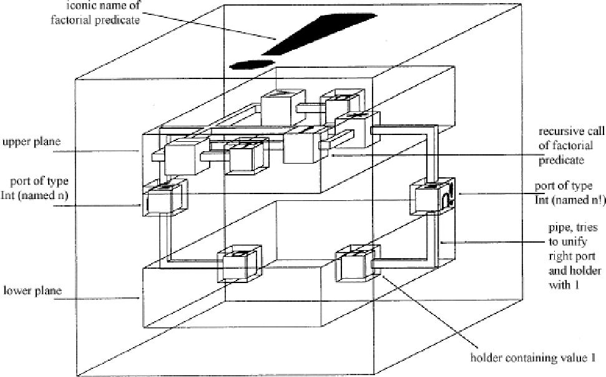
Visual Programming
fun f n = if n=0 then 1 else n*(f (n-1))

Slide 42
Domain-Specific Languages
LaTeX, Postscript
SQL
Shell languages
Graphics
Financial contracts
Music
Controlling robots, chemical plants, aircraft
Spreadsheets

Slide 43
State of the Art, Current Work
FORTRAN, COBOL not gone away, but have changed dramatically
C, C++ still used by legions of real programmers
Java, VB, C# have brought garbage collection and static types to the masses
  Driven by security concerns
  They’re all adopting parametric polymorphism
Counter-trend: rise of dynamically typed ‘scripting’ languages
Sophisticated language-based tools finding bugs in programs written in unsophisticated languages

Slide 44
Challenges
Concurrency
Distribution
Interlanguage working
Security
Data integration

Slide 45
What have we learned?
A lot. Haskell and FORTRAN I are *very* different
Not enough. Programming is still hard.
Expect a 20 year gap between academia and industry
Languages really do evolve
  They’re dynamic, human constructs, constantly absorbing influences and changing in response to environmental pressures
  Different languages are successful in different niches
  The mutation process is a lot more random than you might expect in something which is allegedly designed
They make a difference
  “The limits of my language mean the limits of my world“
  “The purpose of Newspeak was not only to provide a medium of expression for the word-view and mental habits proper to the devotees of Ingsoc […], but to make all other modes of thought impossible.”
Programming language researchers are very fortunate to work on a subject so fascinating which also happens to be industrially important.

Slide 46
The Tao of Programming
The Tao gave birth to machine language.
Machine language gave birth to the assembler.
The assembler gave birth to the compiler.
Now there are ten thousand languages.
Each language has its purpose, however humble.
Each language expresses the Yin and Yang of software.
Each language has its place within the Tao.
But do not program in COBOL if you can avoid it.

